Slide 1
Interaction Styles
HCI
Presenter
  Kimani, Stephen
  SCIT
  JKUAT
Notes:
Opening Slide

Slide 2
Interaction Styles
HCI
Roadmap
Introduction
Command line interface
Menus
Natural language
Form-fills and spreadsheets
WIMP
Notes:
Opening Slide

Slide 3
HCI
Interaction Styles
Introduction
Interaction can be seen as a dialog between the computer and the user.
The choice of the interface style can have a profound effect on the nature of this dialog.
We will look at:
  Command line interface
  Menus
  Natural language
  Form-fills and spreadsheets
  WIMP
Notes:
Introduction

Slide 4
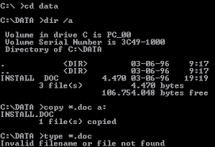
HCI
Interaction Styles
Command-line interface
It was the first interactive dialog style to be commonly used.
It provides a means of directly expressing instructions to the computer, using function keys, single characters, abbreviations, or whole-word commands.
Notes:
Introduction

Slide 5
HCI
Interaction Styles
Command-line interface
Pros
They are powerful because they offer direct access to the system functionality (as opposed to the hierarchical nature of menus).
They are also flexible (the command often has a number of options or parameters).
Cons
They are difficult to use and learn. They are therefore better for expert users rather than for novice users.
Notes:
Introduction

Slide 6
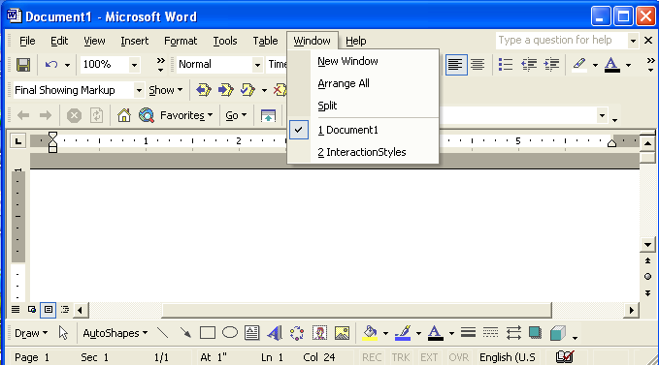
HCI
Interaction Styles
Menus
In a menu interface, the set of options available to the user is displayed on the screen, and selected using the mouse, or numeric or alphabetic keys.
Notes:
Introduction

Slide 7
HCI
Interaction Styles
Menus
Since the options are visible, they are less demanding of the user, relying on recognition rather than recall.
However, menu items still need to be meaningful and logically grouped to aid recognition.
Such interfaces can be purely text based, with the menu options being presented as numbered choices, or may have a graphical component in which the menu appears within a rectangular box and choices are made.
Question: What would an auditory menu interface be like?
Notes:
Introduction

Slide 8

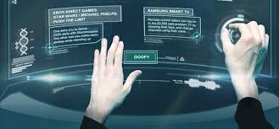
HCI
Interaction Styles
Natural language
The use of everyday words as a means of communicating with the computer has been considered desirable because of its naturalness.
Natural language interfaces enable users to interact with computing devices and applications in a humanlike way (speech, gestures, etc).
Natural language interfaces need to be able to cope with challenges such as: vagueness, ambiguity, background noise, ungrammatical constructions, repetition & stammering, clearing throat, etc.
Several kinds of expert systems and intelligent tutoring systems have been developed using some form of structured subset of a natural language.
Notes:
Introduction

Slide 9
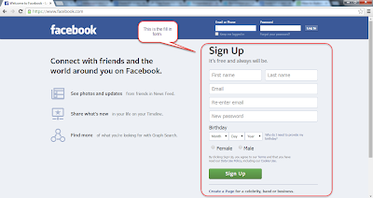
HCI
Interaction Styles
Form-fills and Spreadsheets
Form-filling interfaces are used primarily for data entry but can also be useful in data retrieval applications.
The user is presented with a display that resembles a paper form, with slots to fill in.
Notes:
Introduction

Slide 10
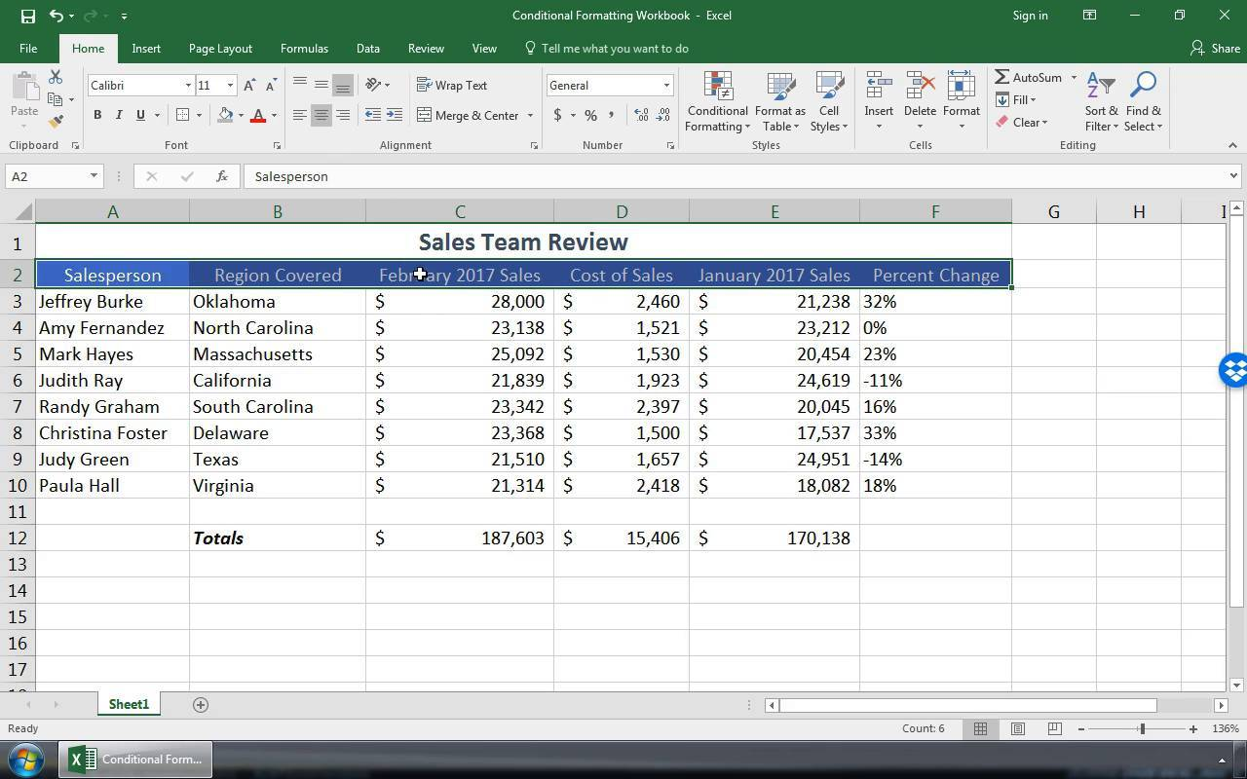
HCI
Interaction Styles
Form-fills and Spreadsheets
The spreadsheet is a sophisticated variation of form-filling.
It comprises a grid of cells, each of which can contain a value or a formula.
Notes:
Introduction

Slide 11
HCI
Interaction Styles
WIMP
Windows, Icons, Menus and Pointers or Windows, Icons, Mice and Pull-down menus
(See next slides i.e. “WIMP User Interface Elements & Others.ppt”)
Notes:
Introduction

Slide 12
Interaction Styles
HCI
Thanks
&
Questions
Notes:
Opening Slide

